Slide 1

OSP
Abby Fellows
sponsored.projects@dartmouth.edu
Dartmouth Library Research Data Services
Lora Leligdon
ResearchDataHelp@groups.dartmouth.edu
Research Computing @ ITC
Research.Computing@dartmouth.edu
Upcoming events:
dartgo.org/RRADworkshops

Slide 2
NIH DMS Plans and Practices
NIH DMS policy introduction
Overview of the elements of DMS
  Highlights of a couple of important sections (data repositories, budget, compliance, etc.)
DMPTool
  Writing and reviewing plans
  RDM guidance
Templates
Institutional resources
  OSP
  Library
  Research Computing
Notes:
Lora: may be good to put in the introduction motivation from NIH for implementing this

Slide 3
Scope & Applicability
Applies to all research, funded or conducted in whole or in part by NIH, that results in the generation of “scientific data”
Scientific data: “the recorded factual material... of sufficient quality to validate and replicate research findings
May include qualitative data or data produced using fundamental basic science techniques
Findings can include unpublished and/or negative/null results
Does not Include: lab notebooks, preliminary analyses, case report forms, physical objects, data from optimizing a protocol, data from existing repositories
End of award share:
  data underlying unpublished key findings, developments, and conclusions
  findings documented within preprints, conference proceedings, or book chapters
Notes:
The new data sharing plan is required for proposal submitted on Jn 25th and later. This applies to all....
Proposals this applies to are
'Scientific data includes any data needed to validate and replicate research findings.
Scientific data does not include laboratory notebooks, preliminary analyses, completed case report forms, drafts of scientific papers, plans for future research, peer reviews, communications with colleagues, or physical objects such as laboratory specimens
Provide your researchers with definition of Scientific data as well and point them to NIH FAQ.

Slide 4
Why does NIH want data to be shared?
Advance rigorous and reproducible research
Promote public trust in research
Allows for validation of research results
Makes datasets accessible
Accelerates scientific progress
Opportunities for increased collaboration
Making data available to public or larger research community
Increases transparency and accountability
Demonstrates stewardship of taxpayer funds
Allows research participants’ contributions to be used in multiple ways
Notes:
Benefit to researcher: Shared data can be cited as products of awards anywhere research products are cited (e.g., bibliography, biosketch, progress report)

Slide 5
Application of Policy
Included:
Research Projects (Rs)
Certain Career Development Awards (Ks)
Small Business SBIR/STTR
Research Centers
Not included:
Training grants (T’s)
Fellowships (F’s)
Construction (C06)
Conference (R13)
Resource (Gs)
Research-Related Infrastructure Programs (e.g., S06)
Policy applies to:
Competing grant applications
Proposals for contracts
NIH Intramural Research Projects
Other funding agreements
Policy does not apply to:
Non-Competing renewals
Administrative Supplements

Slide 6
Data Management Plan vs. Resource Sharing Plan
Data Management & Sharing Plan
Required for all applications subject to the DMS Policy
Resource Sharing Plan
Required depending on proposed science
Describe Data Sharing, including Genomic Data Sharing (GDS)
Respond to IC or program-specific requirements in FOA
Respond to IC or program-specific requirements in FOA
Use the new "Other Plan(s)" attachment
Use "Resource Sharing Plan(s)" attachment
Describe Model Organisms and/or Research Tools
OSP web site contains template language
As this is based on your science, there is no template language

Slide 7
Elements of 2023 NIH Data Management and Sharing Plan
Data type
Describe data collected including amount, data to be shared, rational for sharing, and data documentation
Related tools, software, code
Commercial or open-source? If not is there a plan to share tools/software?
Standards
Standards to be applied to scientific data and metadata – list common data standards
Data preservation, access, timelines
Specific repository(ies) to be used, persistent unique identifiers, and when/ how long data will be available
Access, distribution, reuse considerations
Description of factors for data access, distribution, or reuse: Justify what can’t you share or limit sharing on
Oversight of data management
Plan compliance will be monitored/ managed and by whom
Notes:
There are 6 element that need to be addressed in your plan
Data Type
Summarize the types and amount of scientific data generated in the project BE specific
Describe what scientific data from the project will be preserved and shared and why
list the metadata, other relevant data, and any associated documentation.
Recommend a table with Data Type. Data description. Volume of Data. Repository.
Related Tools, Software and/or Code
Do you need specialized tools to access or manipulate the data? Name the tools and how they can be accessed
standards:
State what common data standards will be applied to data and metadata to enable interoperability of datasets and resources
Data Preservation, Access, and Associated Timelines
Provide name of specific repositories
persistent unique identifier or other standard indexing tools.
Do not include web addresses
List when you will make the data available and how long?
Access, Distribution, and Reuse Considerations
NIH expects that in drafting Plans, researchers maximize the appropriate sharing of scientific data. Describe and justify any applicable factors or data use limitations.
State if access to data will be controlled
If human subject data, describe how will the privacy, rights, and confidentiality of human research participants will be protected. Include information about data sharing language in informed consent
Oversight of data management
Describe how activities outlined in your plan will be delegated, who will be responsible for overseeing and monitoring the study, and the frequency of monitoring
There is significant variation between NIH Institute/Center specific requirements. It is critical to understand the requirements of your individual IC before you start writing your plan.
Because this document is specific to your data and research, not Dartmouth policy, boilerplate institutional language will not fulfill NIH requirements. There are templates and “fill in the blank” examples and later we will introduce an online tool as an option to help write your plan.

Slide 8
Limitations on sharing
NIH expects that researchers will maximize scientific data sharing. Certain factors (i.e., ethical, legal, or technical) may necessitate limiting sharing to some extent.
Justify deviations from the policy of why it’s not possible or reasonable to share data:
  Human subjects- describe IRB’s role in determination
    Informed consent will not permit or limits scope of sharing or use
    Privacy or safety of research participants would be compromised and available protections insufficient
  Explicit federal, state, local, or Tribal law, regulation, or policy prohibits disclosure– cite the law
  Restrictions imposed by existing or anticipated agreements with other parties
  Datasets cannot practically be digitized with reasonable efforts
  NIH respects Tribal sovereignty and supports responsible management/sharing of American Indian / Alaska Native participant data
Give specifics
Notes:
NIH does not expect you to share all your data, but if there is data you are not sharing, you need to provide justification
Policy does not change any of the federal regulations or compliance. The intent is not to have your research scooped, not erode patent protection, the goal is to make all data available that is ethical and legal to share.

Slide 9
When should I share my data?
As soon as possible!
At time of publication:
  Data must be shared no later than the article is available in electronic format or print.
  Release of pre-print does not trigger the NIH data sharing requirement
At the end of the performance period:
  Data not shared through publications must be shared at the end of the performance period unless the grant enters a no-cost extension or is renewed.
  NIH expects sharing of null and negative results.
  When applying for a renewal, sharing data from the previous performance period should be addressed.
Make sure your plan lists data sharing timing for both at the time of publication or end of the performance period, whichever comes first.

Slide 10
Budget considerations:
NIH staff have indicated they expect to see costs
  if you have no costs, explain in justification why
Determine repository costs
  Repository specific
  May include data deposit and/or long term storage fees
  Range from free to $1000s, based on dataset size, security/permissions, curation levels
Preparing data, metadata, de-identification, etc: Budget personnel effort
  External service
  Member of the project team
Resources to help with costs to consider:
  OpenAIRE Estimating Costs RDM Tool (this is in Euros and needs conversion to USD)
  NIMH Data Archive (NDA)’s budgeting guide and NDA Data Submission Cost Estimation Tool
Notes:
Are there repository specific costs?
Do they charge for data curation?
Large datasets may have transfer costs
are there specific security requirements you have to pay for?
For data specific costs, consider if this will involve effort of someone on your project team or if you are hiring an outside service.
costs for developing supporting documentation
Formatting data to community or repository standards
Support services or service center?
Deidentifying data
Certification service?
Preparing metadata
There are some resources available to consider costs
OpenAIRE is a European estimation tool that gives some hard examples of costs of data management and sharing
The NIMH has a budgeting guide and data submission cost estimation tool specific to their data archive

Slide 11
Allowable Data Management and Sharing Costs:
Allowable Costs: Preparing research data for sharing and sharing it.
Curating data/Developing supporting documentation
  Formatting data into community standards like Common Data Elements
  De-identifying data
  Preparing metadata
Local data management considerations
Preserving and sharing data via repositories, such as data deposit fees
NOT considered data sharing costs:
Costs associated with the routine conduct of research
  Costs associated with collecting data
  Research data access fees
Infrastructure costs that are included in institutional overhead (for instance, Facilities and Administrative costs
IMPORTANT: Costs Must be incurred during the performance period

Slide 12
Budget format
DMS costs must be included with other costs in the appropriate cost categories (e.g., personnel, equipment, supplies, other expenses), following standard form instructions.
Personnel costs associated with data management and sharing activities are entered in Senior/Key person or Other Personnel as part of their overall effort
Justification will include a total of the data sharing costs

Slide 13
DMS Plan Budget Justification
If no costs: ”No costs incurred for Data Management and Sharing”. You may include an explanation
Recommended length no more than ½ page
Include summary of type and amount of scientific data to be preserved and shared and the name of the established repository(ies) to be used
Use general cost categories such as curating data and developing supporting documentation, local data management activities, preserving and sharing data through established repositories, repository costs, etc.
Include a description of personnel effort
Include an amount for each category and a brief explanation.
Detailed Budget: Include separate section in justification labeled, “Data Management and
Sharing Justification”
Modular Budget: A separate upload named ”Additional Narrative Justification” with the header in the document, “Data Management and Sharing Justification”
Notes:
Peer Reviewers will see this as part of review to comment on appropriateness.

Slide 14
Data Management and Sharing justification:
Need this exact label
Total request
Summary of type of data and name of repository
The total cost for Data Management and Sharing is $25,000 ($5,000 per year).
This study will collect demographic, physiological, and performance data from 200 Nordic athletes as they test new formulations of ski wax and will be compared to existing wax performance data. The de-identified data will be deposited in the US Ski and Snowboard World Acceleration neXus data repository (USWAX).
The cost includes $750 per year for data deposit and repository fees and $4250 per year for personnel effort to develop supporting documentation, format the data, and deposit in the repository.
Repository fees
General cost categories

Slide 15
Oversight of Data Management
The primary investigator is responsible for ensuring that the DMS plan is executed.
Establish a regular interval for data review and management.
Describe how the PI will monitor compliance with the plan including frequency.
List roles of people responsible for implementing the plan (e.g., Post-Doc, Research Scientist, Research Assistant, etc.)
List description of tasks (e.g., metadata creation, formatting data for sharing, de-identifying data, etc.)
NIH expects compliance will be reported annually in the RPPR

Slide 16
DMS Plan Stages
Plan Separate from Application
Peer Reviewers will not see plan
Reviewers will evaluate budget
JIT Review
PO will review plan
Plan incorporated into NOA
Reporting
Include in RPPR
Compliance affects future funding
Plan Changes
Prior approval required
Revised NOA will note updated plan
Non-compliance can terminate award

Slide 17
How do you report DMS Plan changes?
All changes in PDF format are submitted by a Signing Official at OSP
Pre-Award
DMSP Revision section of the Just In Time Screen
Post-Award
RPPR: Section C.5.c: “Upload Revised Data Management and Sharing Plan”
Off Cycle Requests: ERA Commons Prior Approval Module “Prior Approval – DMS Request”
Provide the rationale and justification for the requested changes
Provide updated budget if the changes impact the budget
Attach the revised DMS Plan

Slide 18
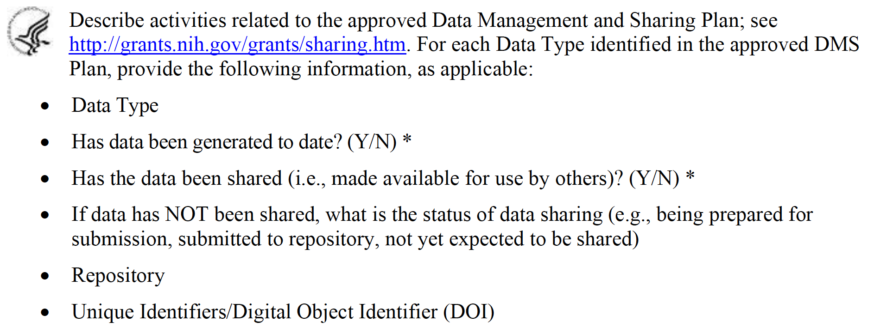
RPPR Changes
NIH has a new RPPR instruction guide with instructions of DMS reporting
RPPR will automatically indicate if new questions are applicable
Report if there are changes to plan and if so, upload new plan

Slide 19
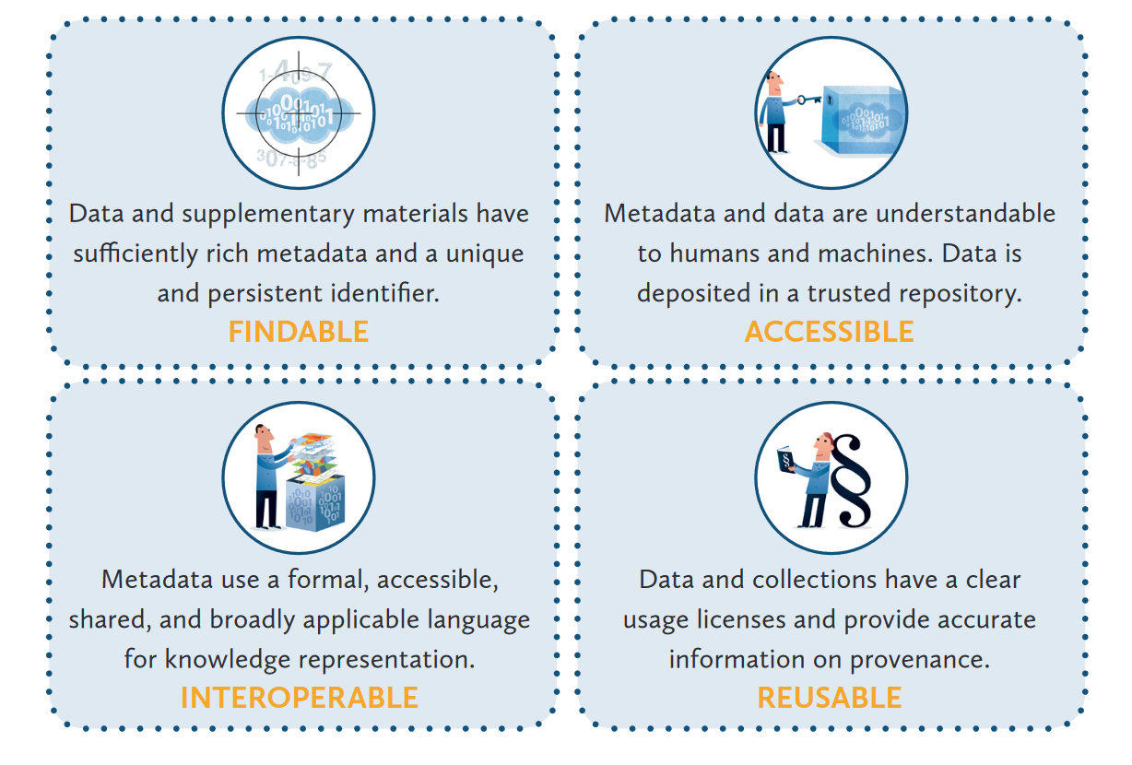
Collecting data with sharing in mind
Reproducible Research using FAIR Data
LIBER Implementing FAIR Data Principles: https://libereurope.eu/wp-content/uploads/2020/09/LIBER-FAIR-Data.pdf

Slide 20
Choosing a repository: Be specific
NIH strongly encourages subject-specific, open access Data Sharing Repositories as a first choice.
Researchers should review the specific guidance to determine designated data repository(ies).
If no repository is specified by NIH,
Primary consideration should be given to repositories that are discipline or data-type specific to support effective data discovery and reuse. NIH recommended repositories are provided.
Evaluate repositories on desired characteristics, such metadata, access, security, preservation, etc.
Human subjects data requires additional considerations.
If no appropriate discipline or data-type specific repository is available:
Submit smaller datasets (less than 2 GB) to PubMed Central as supplemental information
Select a generalist repository (Dryad, Figshare, OSF, etc)
Use Dartmouth Dataverse, our institutional repository
The use of Unique Persistent Identifiers (PID) is encouraged, and their use is a desirable characteristic of data repositories

Slide 21
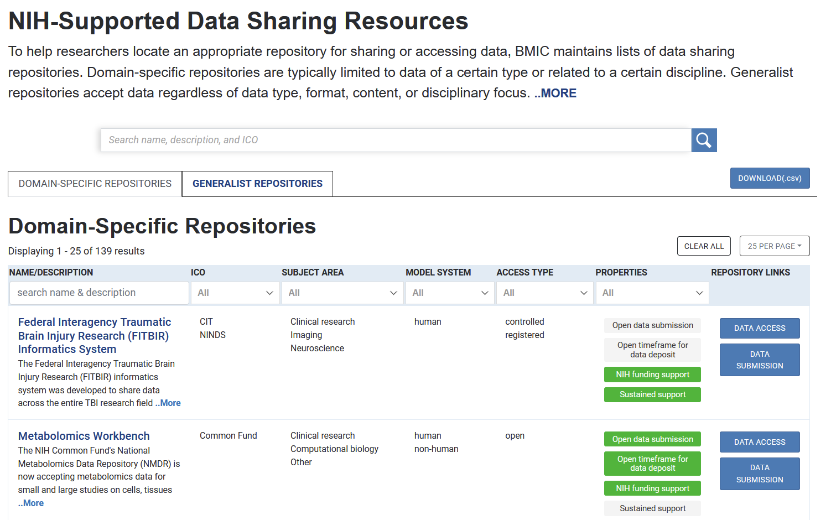

Slide 22
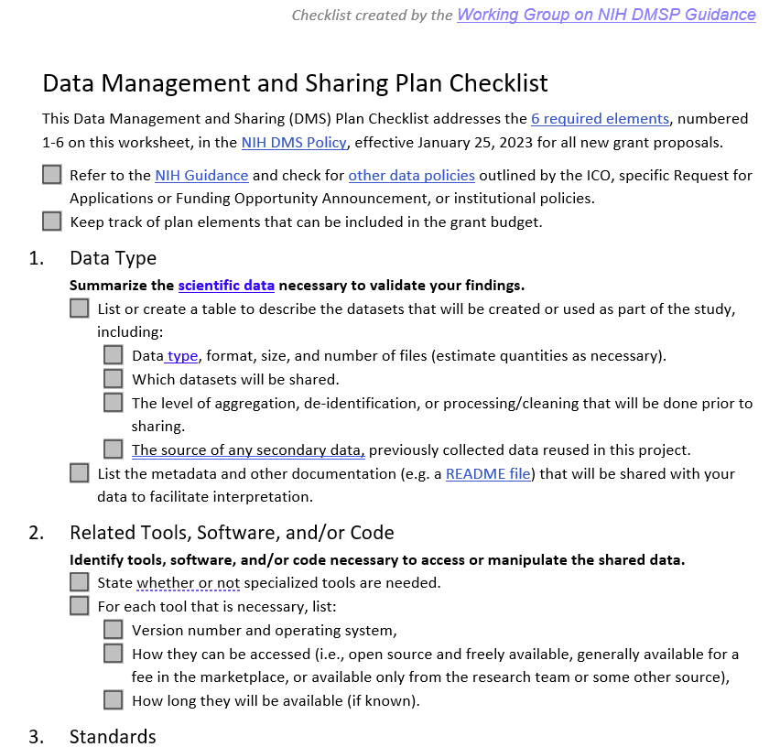
Writing your DSM Plan
Write
DMPTool.org for templates and guidance
Draft Data Management and Sharing Plan Template
NIH Sample Data Management Plans available
Review
Data Management and Sharing Plan Checklist
ResearchDataHelp@groups.dartmouth.edu

Slide 23
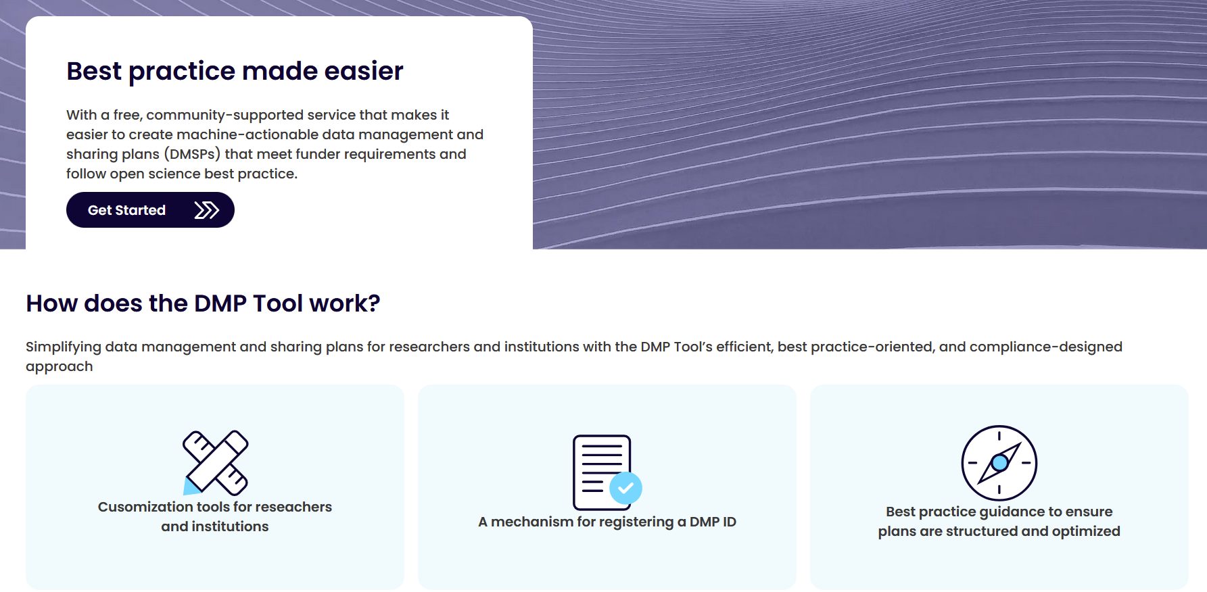
https://dmptool.org/

Slide 24
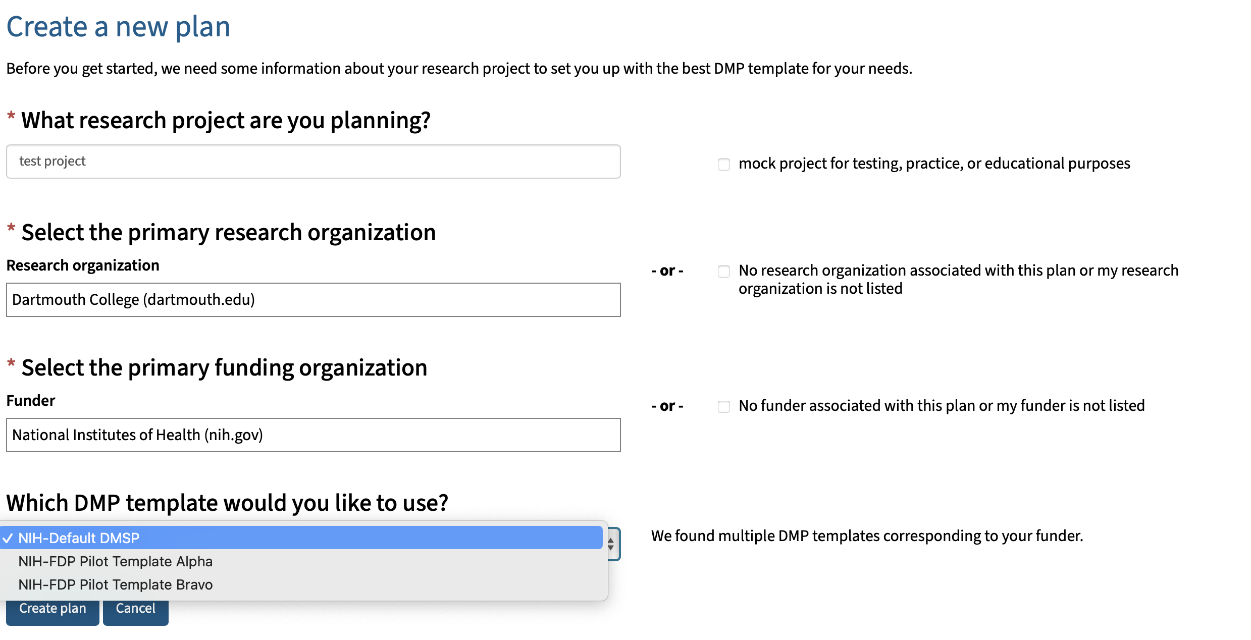
https://dmptool.org/plans/new
Type NIH here
Choose NIH-Default

Slide 25
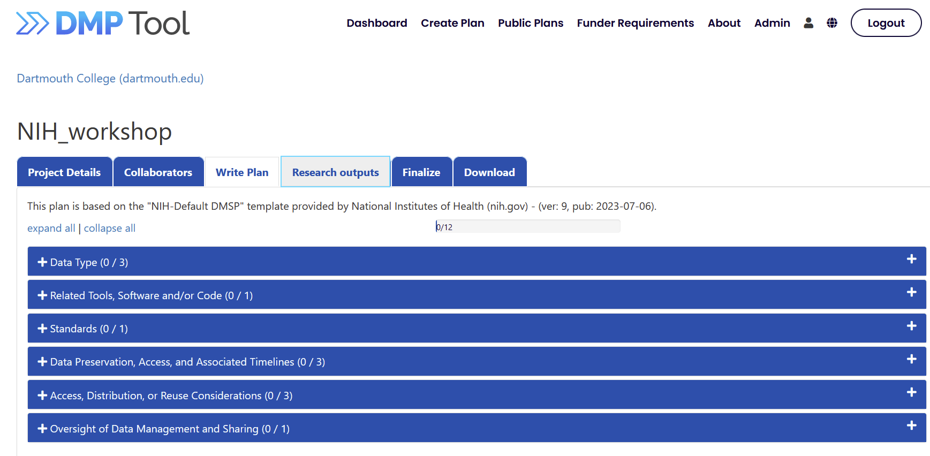
Write your plan

Slide 26
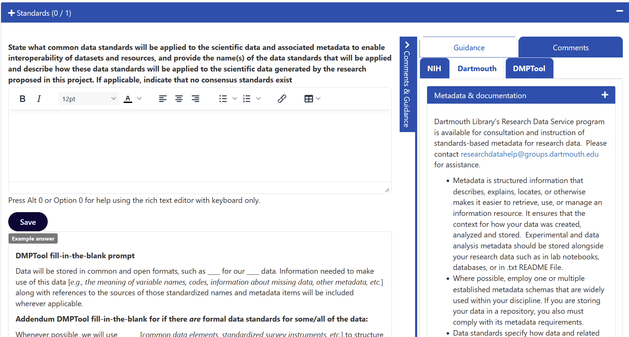
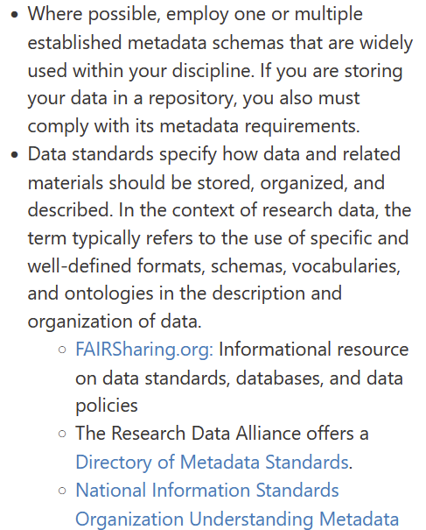

Slide 27
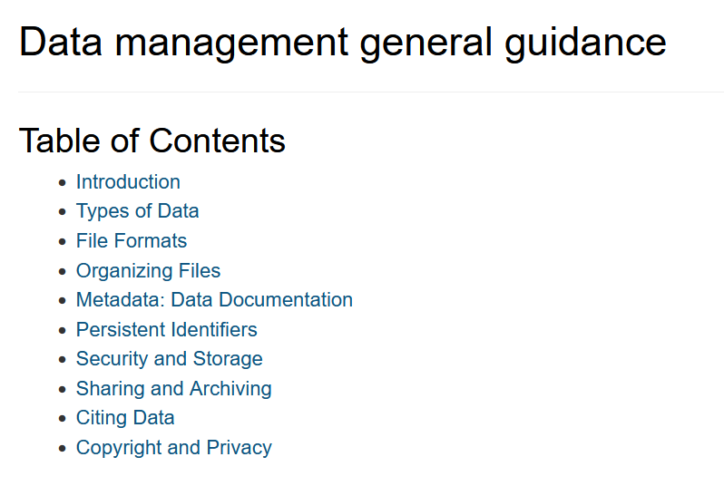
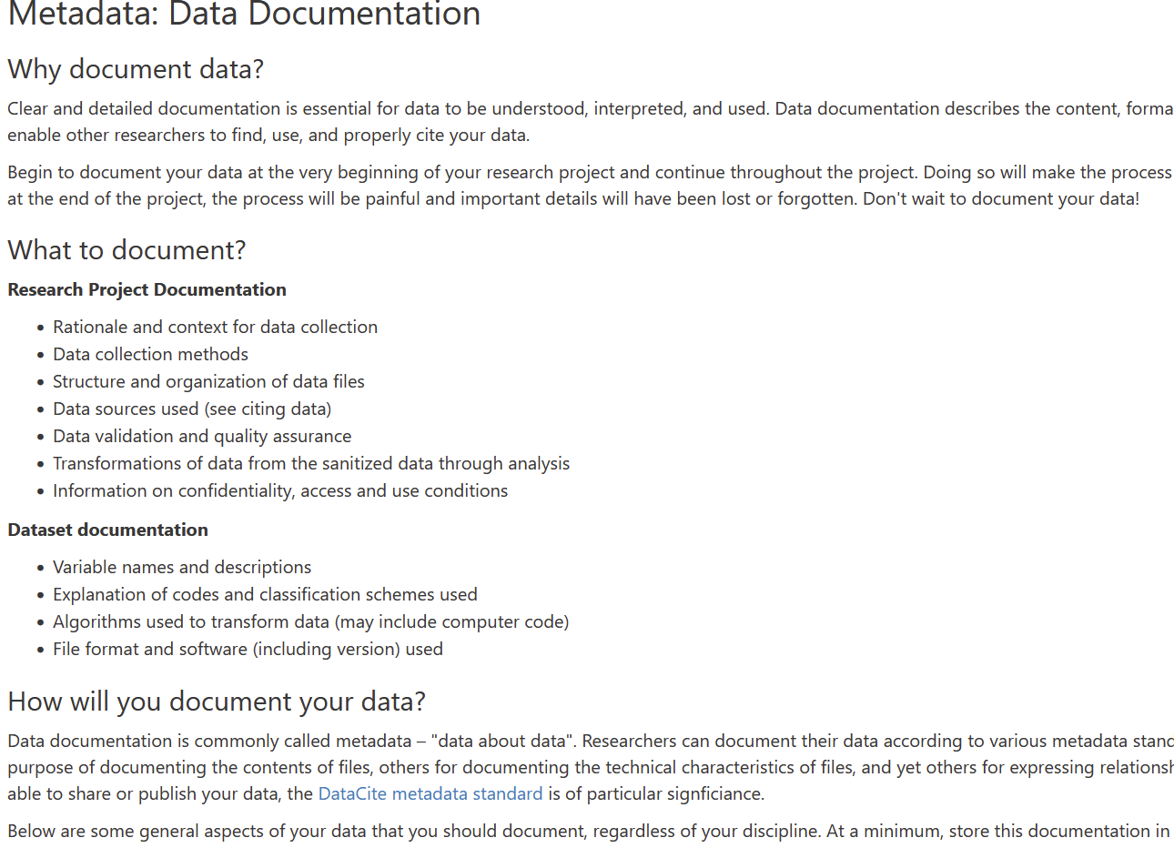
https://dmptool.org/general_guidance

Slide 28
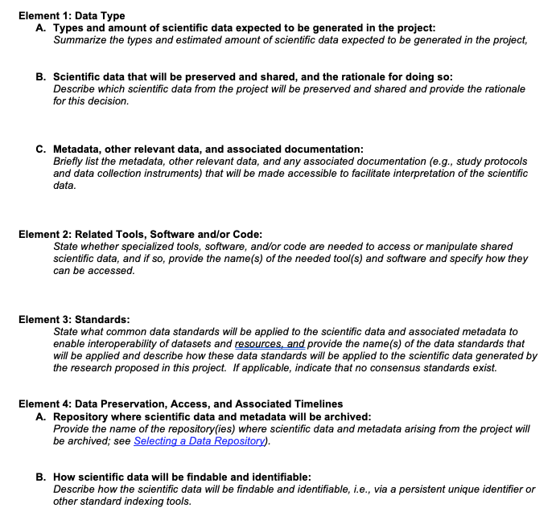
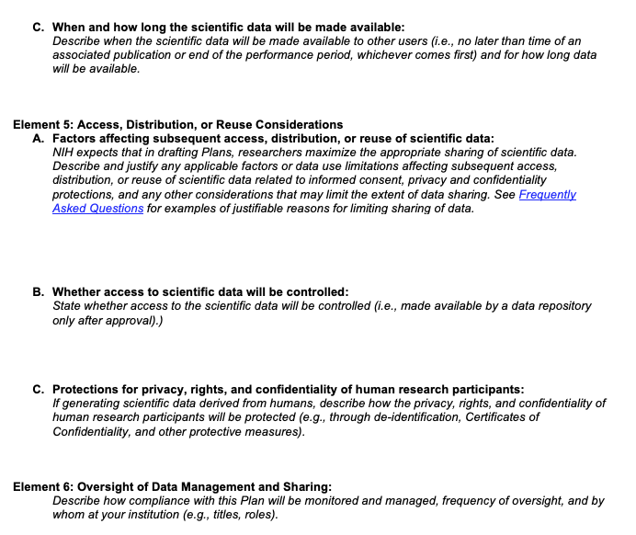
Templates: NIH: new one anticipated after May 2025

Slide 29
Updates
October 1: RPPR has started to capture information about DMS status information changes to the plan, and upload a new plan (when applicable)
NIH will rollout new template anticipated after May 2025:
  More concise
  Table format for data
  Reduce duplicate entry of information
Data types from template will eventually roll into the RPPR for reporting
FDP is working on a budgeting pilot to:
  Establish common cost principles
  Identify types of costs

Slide 30
Reoccurring Issues identified by NIH
Not clear of what is generated vs. shared. Both need to be described
  Species/source, formats shared, amount, metadata
  Using a table is recommended
  If you list data in section 1a, describe if you are sharing it in section 1b
Incomplete information for Genomic Data Sharing – please note there are new data security requirements
Not listing an established repository or not listed which data goes into what repositories listed. Using generalist repositories when specific ones exist
  Confusion of local data storage vs. repository
Sharing “by request” or with PI-control. Use a repository that has an established control processes when needed
DMS budget justifications are missing or not clear, no explicit support for DMS plan activities like personnel effort for preparing submissions.
No costs budgeted for DMS

Slide 31
Other considerations and reminders
Be clear about which data, when, where, and how
Be consistent between sections of the plan.
Justify anything that deviates from Policy expectations and guidance (Why it’s not possible or reasonable to share)
Check for Funding Announcement and NIH Institute specific instructions!!!
URLs and Hyperlinks are NOT allowed in the plan
List Specific repositories, you may have more than one
NIH has a library of sample plans on their web site for different contexts.

Slide 32
Questions?
Your feedback is important to us: Dartgo.org/feedback
Notes:
For Dartmouth College researchers, please contact the Office of Sponsored Projects
For Dartmouth Hitchcock researchers, please contact awards@Hitchcock.org

